Slide 1
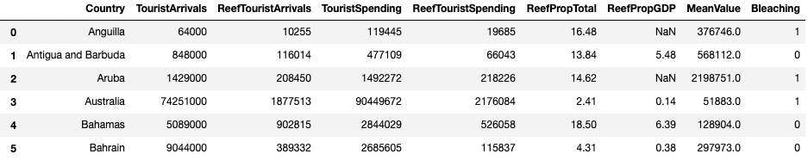
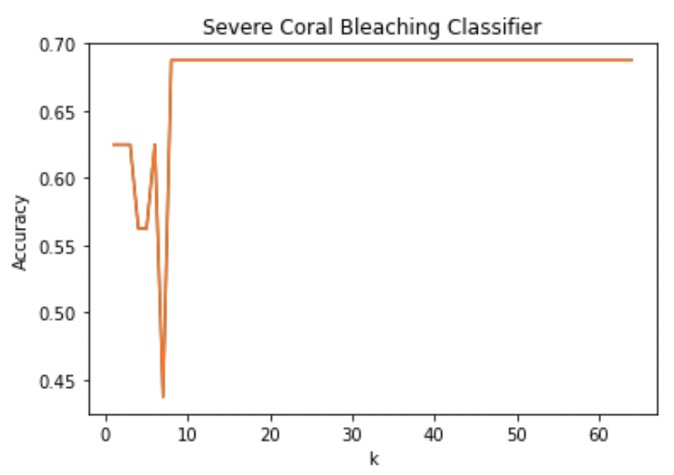
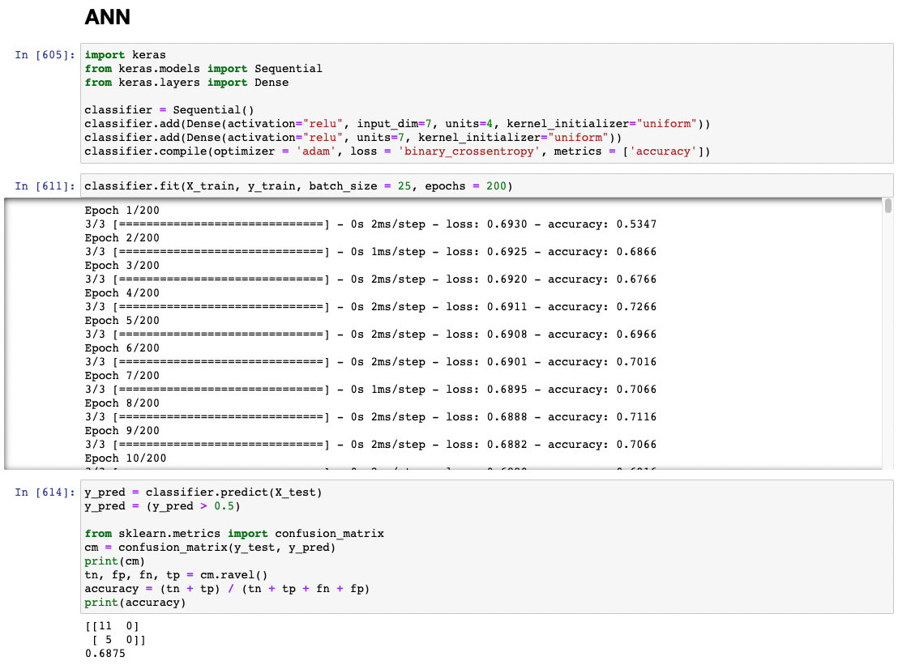
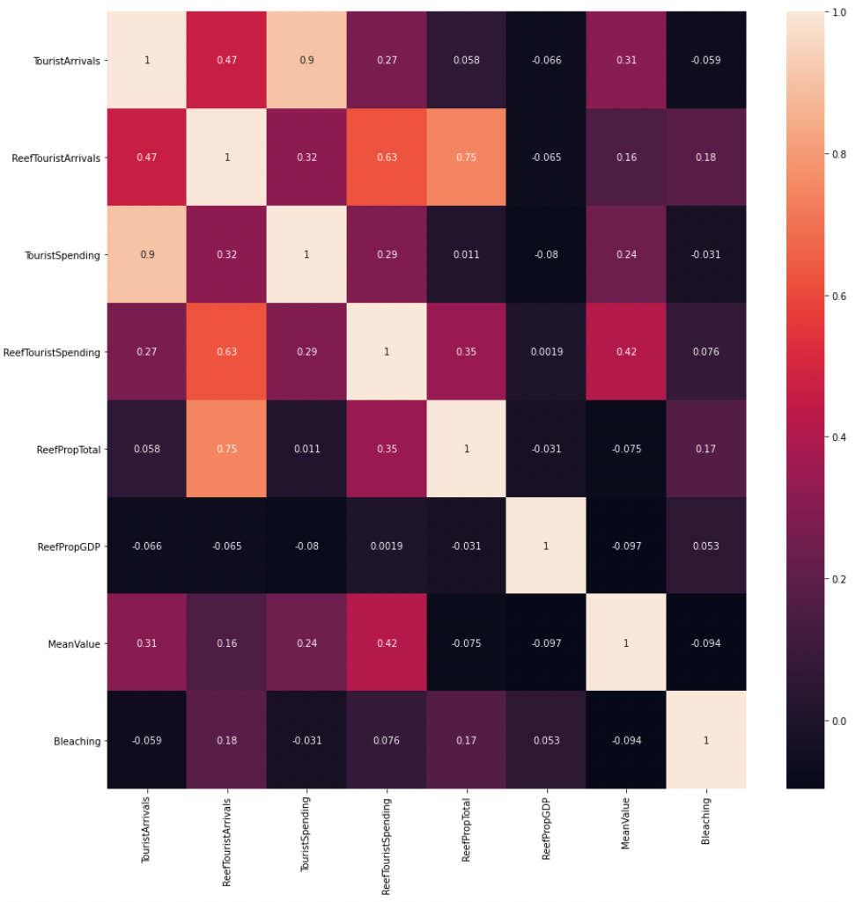
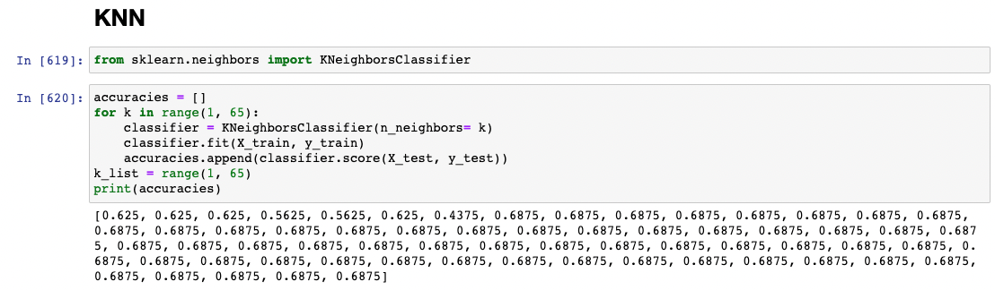
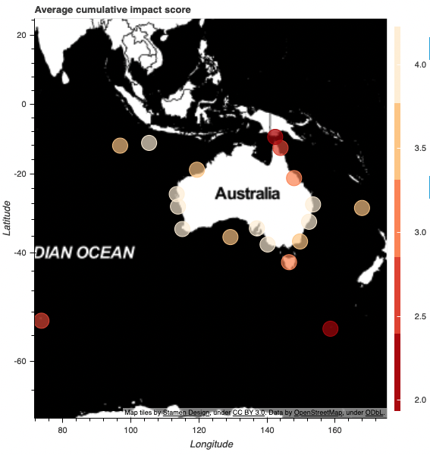
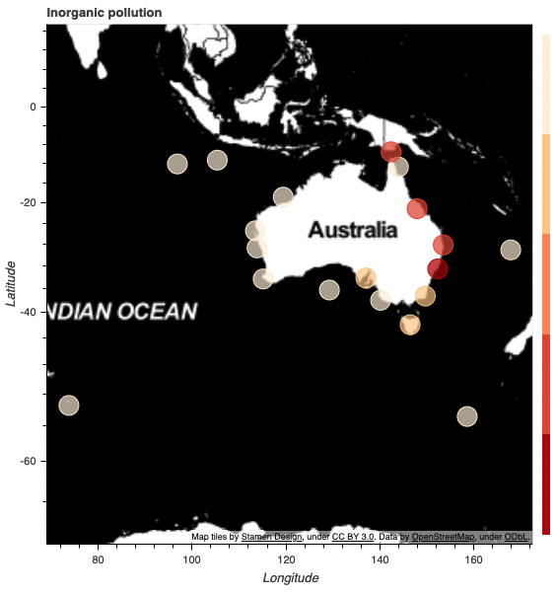
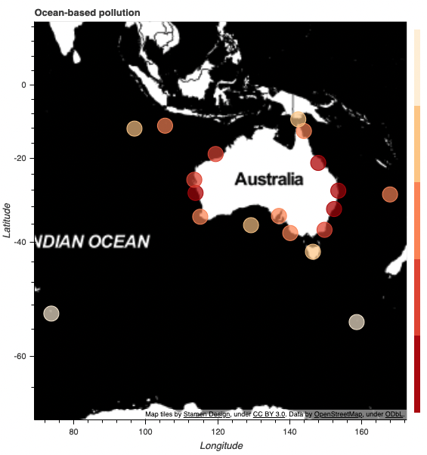
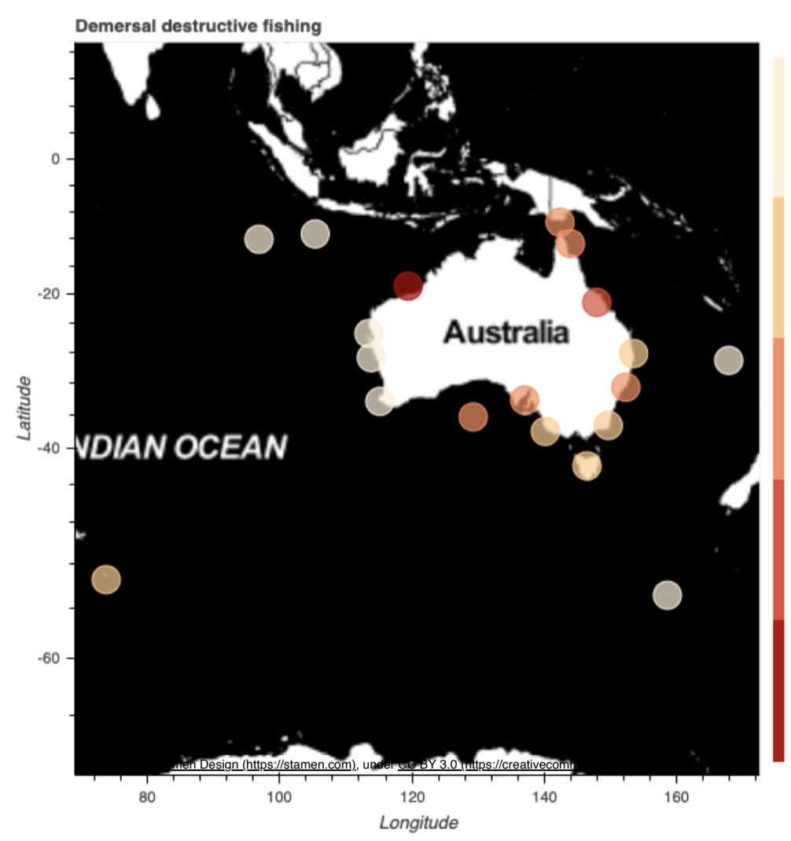
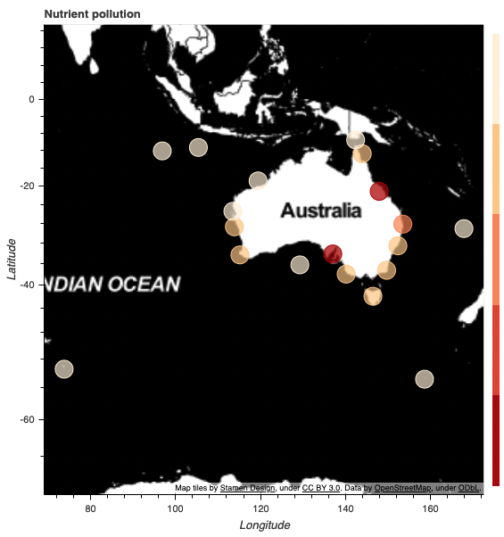
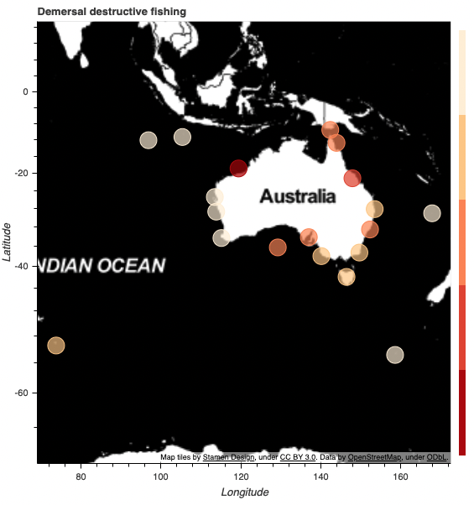
Alessandro Barlotta, Don Bonifacio,
Logan Bukowski, Sophia Capili,
Kiernan Geoghegan
Oceanography Mr. Werner
Block 1 // January 2021
Predicting Severe Coral Reef Bleaching
Based on Global Anthropogenic Activity
DISCUSSION
.Correlating specific locations with information regarding anthropogenic impact on coral reefs (e.g. runoff and sedimentation, agricultural pollution, and land development) can indicate priority locations where coral reefs are being degraded as the result of human activity and interaction (Richmond, 1993). Coral reefs that are currently under vast amounts of anthropogenically induced stress can be used as indicators of poor water quality or detrimental human impact (Richmond, 1993). Data obtained while studying the decline of global coral reef populations can be used to set stricter regulations governing anthropogenic activity around bodies of water (Richmond, 1993). The onset of anthropogenic impact on coral reefs imply a cascading and negative outlook — not only for recreational and tourism activities, such as diving and snorkeling, but also worldwide biological diversity (Mansour et al., 2017). Home to 25% of all marine life, coral reefs are in serious decline despite small and large scale efforts to restore them (Hughes et al., 2003). Coral reefs not only provide shelter and a source of food for many aquatic species, but they are also vital to the fishing and pharmaceutical industries (NOAA, 2007). Fishermen rely on coral reefs to provide shelter to desirable sport fish and several pharmaceutical companies have turned to marine corals as a new source of medicine (NOAA, 2007). If action is taken now to protect the globe’s remaining coral reefs, damage not only to the ecosystem, but also to the human way of life, can be mitigated (Richmond, 1993).
ABSTRACT
OBJECTIVE
Coral reefs, crucial ecosystems that collectively support 25% of the ocean’s fish, suffer coral bleaching or “whitening.” Anthropogenic pollutants like agricultural pesticides from rivers, wastewater discharged into the sea, and sunscreen and personal care products (e.g. benzophenone, octyl methoxycinnamate) that accumulate in high-human activity areas and disrupt organisms’s reproduction and growth cycles.Such heavy human activity in the water and in the regions around coral reefs has had a disastrous effect on many reefs around the world. Other human activities also have had a very serious effect on the wellbeing on reefs including but not limited to poorly planned coastal development and off shore fishing. If human activity, particularly tourism, and coral reef bleaching are mapped, then areas of high human activity would result in critical coral reef damage. This study will heavily use machine learning algorithms to predict whether a country will have severe bleaching based on tourism. Given parameters of anthropogenic activities, the resulting machine learning model can predict severe coral reef bleaching with a 69% accuracy. Action can be taken from the predictions (1) to pinpoint what places need to mitigate their anthropogenic impact and (2) illustrate the alarming spread of coral reef damage.
Use machine learning algorithms to predict whether a country will have severe bleaching based on anthropogenic activity.
METHODOLOGY
1. Collect data: Major Reef Tourism Countries and Coral Bleaching Data
Reef-related tourism data is retrieved from the summary data of a previous study mapping reef-based tourism revenue (Spalding et al., 2017). The data includes relevant tourism information, such as reef tourism revenue and the number of reef tourists, on all countries and territories with a total coral reef area of >50km-2 and a total reef-related expenditure of >$10 million per year. Worldwide coral bleaching data is retrieved from the coral bleaching documentation compiled by the Biological and Chemical Oceanography Data Management Office. From these two datasets, one data set is formed containing both tourism-based parameters and a corresponding boolean indicating ‘severe’ coral bleaching, which is described by the Australian Institute of Marine Science to be >60% community bleaching (“Coral bleaching events”, n.d.).
2. Setting up Machine Learning Algorithms
Machine Learning
In the most basic terms, machine learning is the use of both computational algorithms and statististics to find patterns in data. If the data is digital and can be read into a computer, it can be used in a machine-learning algorithm (Hao, 2020). There are three common types of machine learning: supervised, unsupervised, and reinforcement learning. Though the two other approaches of machine learning are useful in particular situations, this study focuses on the use of supervised learning, a type of learning which involves the user assigning both input and output data. The algorithm would then try to find patterns in the input data to lead to the correct output with the end goal of creating a model where the given input data can correctly predict the output (Wilson, 2019).
Preparing the Data
The data that will be used for the machine-learning model is the coral reef and reef-tourism revenue summary data retrieved from a previous study (Spalding et al., 2017). To begin, the data must be properly prepared for the algorithms. To do this, all null values are replaced with the median values of that column; this is done based on the assumption that the median is more applicable than the mean when referring to measurements such as revenue or GDP.
K-Nearest Neighbors
The prepared data will now be run through a simple k-nearest neighbors classifier model. The algorithm is run and the accuracy of the model is found using a confusion matrix.
Table 1. Preview of the dataset.
INTRODUCTION
Figure 6 . Line plot displaying the accuracy of the machine learning program. K refers to the number of nearest neighbors in a KNN algorithm. As illustrated by the line plot, the accuracy of the program fluctuates until the number of nearest neighbors nears 10, where it then stabilizes at ~69%.
Coral reefs are massive biodiverse ecosystems that can be found in various parts of the world, such as shallow and deep tropical waters, and even cold pockets of water (NOAA, 2013). Coral reefs are sometimes referred to as the “rainforests of the sea” (NOAA, 2013). These ecosystems contain more than a million of the world’s species, and “25% of the ocean’s fish depend on healthy coral reefs” (NOAA, 2013). Coral polyps are the organisms that build the reefs and may form sizable colonies or remain solitary (NOAA, 2014). The overall growth of coral reefs is fueled by biological processes, as habitats for aquatic organisms are created by “the growth and death of reef building corals, sponges, and other immobile marine animals” (Hughes et al., 2003). In order to prosper, reefs have developed symbiotic relationships with zooxanthellae, a photosynthetic algae that provides oxygen and carbohydrates for the coral and is able to remove waste (NOAA, 2013). In terms of their benefits, coral reefs are important for coastline protection, as they are “often the first line of defense against strong tropical storms for coastal communities” (Hughes et al., 2003). Additionally, they sustain almost half a billion people with food and income (Hughes et al., 2003).
Reefs cover 249,423 km2 of total area worldwide. Of these thousands of kilometers of reefs approximately 29% are used for tourism, generating over thirty five billion U.S. dollars worth of revenue every year. This tourism can be broken down into adjacent reef tourism and on reef tourism. Adjacent reef tourism includes a wide array of benefits from coral reefs, including the use of nearby beaches, views for tourists, and the consumption of locally sourced seafood. This type of reef tourism comprises 45%, or roughly sixteen billion U.S. dollars worth of revenue. The other type of reef tourism is on reef tourism, which is associated with activities that take place in-water, directly near the reef. Examples of on reef tourism would include diving and snorkeling. This type of tourism accounts for about nineteen billion U.S. dollars worth of revenue, or 54% of total reef revenue.
Figure 1. . Artificial neural network (ANN) code with ANN accuracy of 0.69.
Figure 7. Heatmap depicting the correlations between various economic parameters, and the income produced by reefs. Values closer to 1 indicate strong direct correlations. Constructed using Numpy and Seaborn packages.
CONCLUSION
Data regarding anthropogenic activity in a certain region can be used to indicate potential areas of severe bleaching. This experiment shows that creating a model to predict severe coral bleaching based on reef-related tourism data successfully results in a moderately accurate prediction model. Although, tourism is just one of many factors that can affect the conditions of a coral reef system. While the model shows a rather accurate prediction rate, additional data on other forms of anthropogenic activity may be required in future experiments to produce a more accurate model. As the accuracy of coral bleaching models increases, these models could be more reliably used to predict potential severe bleaching sites. Once potential bleaching sites are predicted by the models, appropriate mitigation efforts can be made.
PROBLEM STATEMENT
Figure 2. KNN code with accuracies with varying K-neighbors.
Coral bleaching occurs when coral experiences “whitening” due to “the loss of a coral’s symbiotic algaeâ€¦ or the degradation of the algae’s photosynthetic pigment” (Rafferty, 2019). The algae, typically zooxanthellae, that reside in the tissue of corals can degrade for a multitude of reasons ranging from increased water temperature to changes in seawater chemistry (Rafferty, 2019). Other causes of bleaching include anthropogenic pollutants like agricultural pesticides from rivers, wastewater discharged into the sea, and sunscreen and personal care products (e.g. benzophenone, octyl methoxycinnamate) that accumulate in high-human activity areas and disrupt organisms’s reproduction and growth cycles (Greenpeace East Asia, 2020). Bleaching does not directly kill coral; however, prolonged periods without zooxanthellae leads to starvation and a high-susceptibility to disease in bleached coral (Oceana, 2020).
Such heavy human activity in the water and in the regions around coral reefs has had a disastrous effect on many reefs around the world. Negative impacts have included instances of loss of marine life and overall degradation of reefs as a direct result of diving and snorkeling. Other human activities also have had a very serious effect on the wellbeing on reefs including but not limited to poorly planned coastal development and off shore fishing.
If human activity, particularly tourism, and coral reef bleaching are mapped, then areas of high human activity would result in critical coral reef damage. This study will heavily use machine learning algorithms to predict whether a country will have severe bleaching based on tourism. Action can be taken from the predictions (1) to pinpoint what places need to mitigate their anthropogenic impact and (2) illustrate the alarming spread of coral reef damage.
RESULTS
SELECTED REFERENCES
Dataset: Global Bleaching and Environmental Data. (2019, July 18).
Retrieved January 2, 2021, from
https://www.bco-dmo.org/dataset/773466
Greenpeace East Asia. (2020, September 24). What is coral? What are the
causes, impacts, and solutions of coral bleaching? Retrieved January
01, 2021, from https://www.greenpeace.org/eastasia/blog/6119/what-is
coral-what-are-the-causes-impacts-and-solutions-of-coral-bleaching/
Hao, K. (2020, April 02). What is machine learning? Retrieved January 06,
2021, from
https://www.technologyreview.com/2018/11/17/103781/what-is
machine-learning-we-drew-you -another-flowch art/
Hughes, T. P., Baird, A. H., Bellwood, D. R., Card, M., Connolly, S. R., Folke,
C., â€¦ Roughgarden, J. (2003). Climate change, human impacts, and
the resilience of coral reefs. Science, 301(5635), 929â€“933.
https://doi.org/10.1126/science.1085046
Figure 3 . Average cumulative impact score for coral reefs near and around Australia. Darker red spots indicate higher rates of cumulative anthropogenic effect (e.g. pollution, coral bleaching, destructive fishing, and nutrient runoff).
Figure 4.. Bokeh maps of different parameters, red being higher scores.
Figure 5. The effects of destructive benthic fishing around Australia. Fishing methods such as dredging damage the ecosystem and expedite the rate at which coral bleaching occurs.
Notes:
1

